Slide 1
The Beatle
Team D# Presents
Our Vision:
Create a metronome that changes speed with the song.

Slide 2
Example
Of The
Problem

Slide 3
The Beatle
Solution:

Slide 4
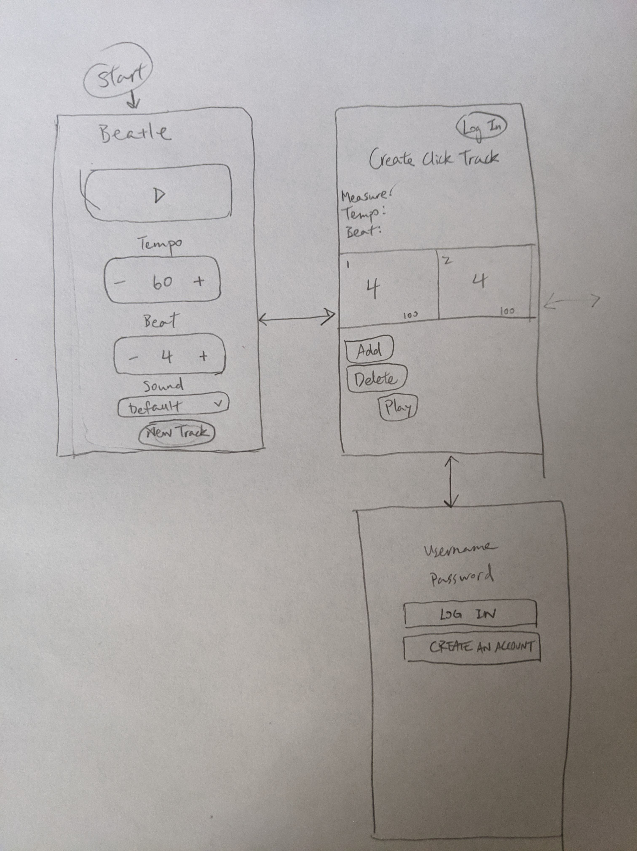
UI
Model

Slide 5
DEMO

Slide 6
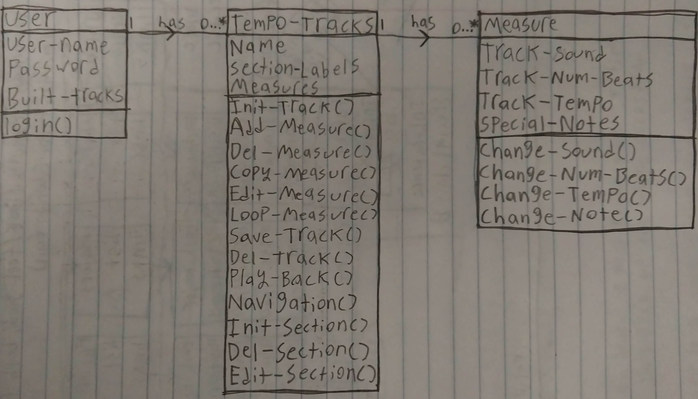
Domain
Model

Slide 7
Deployment
Diagram

Slide 8
Assessment

Slide 9
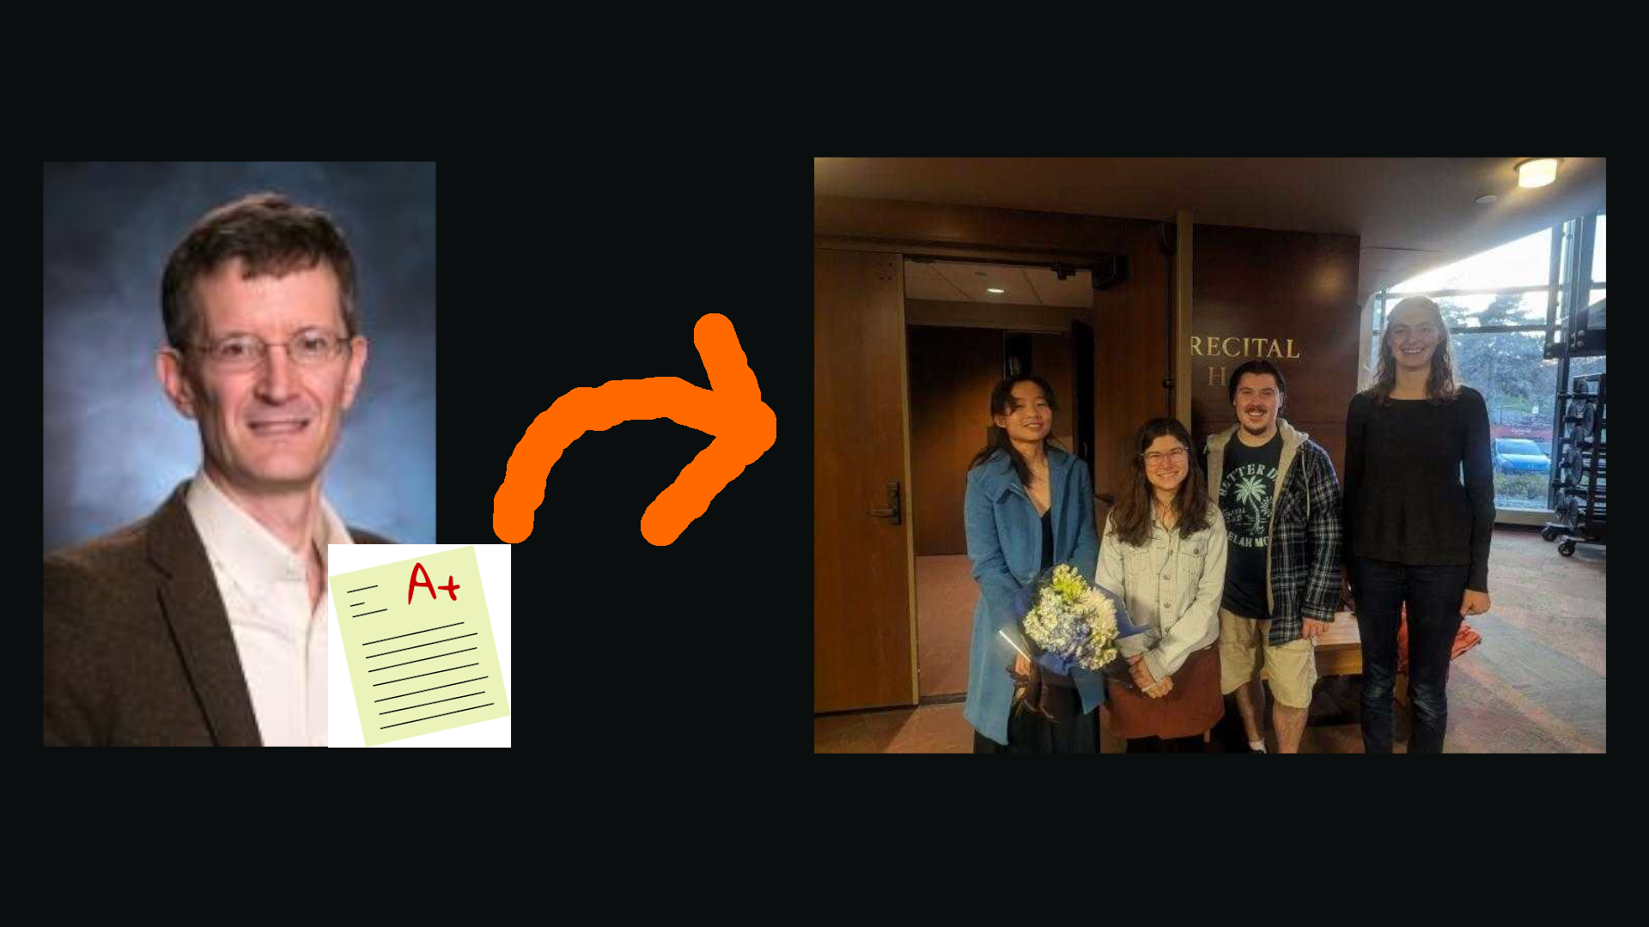
In Conclusion

Slide 10
Q&A

